Slide 1

How we teach Reading at
St John Fisher RC Primary School
New parent meeting

Slide 2
RWI IS A Government approved Synthetic Phonic Scheme
We follow the Read Write Inc Programme RWI
RWI is a complete phonics programme which helps all children learn to read fluently and at speed so they can focus on developing their skills in comprehension, vocabulary and spelling. The programme is designed for children aged 4-7 but we continue teaching RWI to children beyond the age of 7 if they still need support with their reading.
https://www.youtube.com/watch?v=MbWIujM1WGM

Slide 3
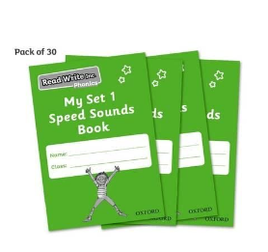
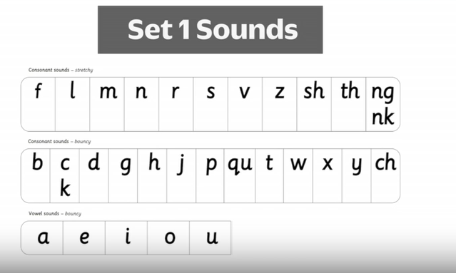
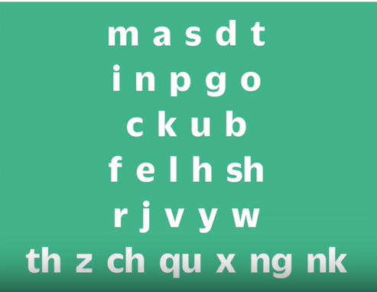
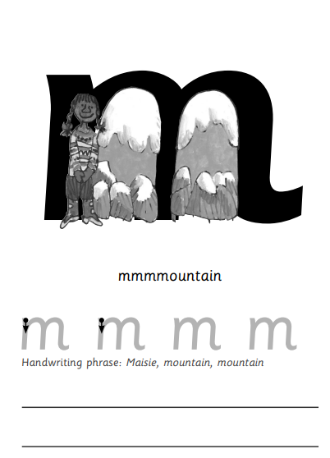

In Reception, we Begin with Set One speed Sounds
In Reception, your will child learn the first thirty one sounds. We call these Set One Sounds.
Each child will have their own sound book that they will bring home each evening to practise the sound they have learnt that day.
This is the order that the sounds are taught

Slide 4
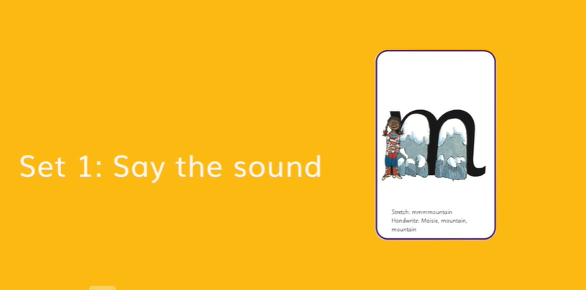
Children will learn that we
Stretch some sounds, mmmm,fffffff,lllllllll
Bounce some sounds
ooo,eeee,,ccccc
We use pure sounds to make it easier for the children to learn to blend.
During a daily phonics lesson we want children to
hear a sound,
say the new sound – on its own and in words
Read the sound
We use MTYT (MY TURN YOUR TURN) to practise saying sounds.

Slide 5
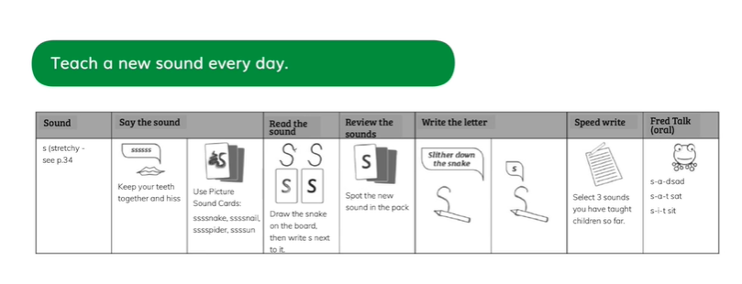
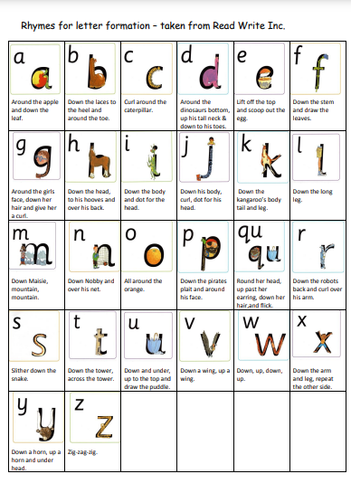
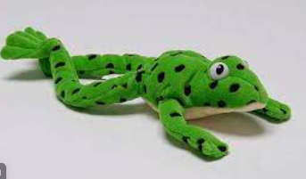
Daily Phonics Lesson
Rhymes help support letter formation.
Say the sound – stretchy sssssss –
Picture cards -Say the sound in a word - ssssnake
Read the sound -drawn on the board
Spot the sound card shuffled amongst other sound cards
Teacher model writing – say the rhyme – air write – children write on whiteboards and in books – recap on other sounds to write
Fred talk BLEND – oral practise Fred!
https://www.youtube.com/watch?v=dEzfpod5w_Q

Slide 6
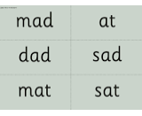
Once the children know the first ten sounds m a s d t,
they will practise blending words… mat, at, mad, sad, dad, sat – written on green cards and known as ‘green words’.
We remind children that Fred can only talk in Fred Talk – saying each sound one at a time. So we help Fred by blending the sounds together.

Slide 7
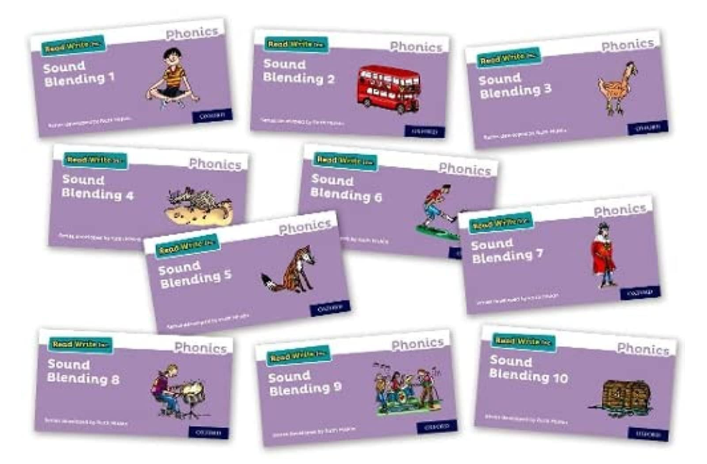
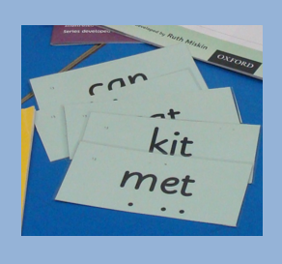
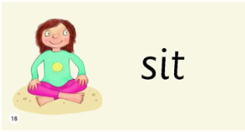
Every day, children will practise
Spelling words by rearranging letters using flashcards/magnetic letters
Saying each sound and blending words
Every child is different. Some can blend the sounds together immediately, for other children it can be a real challenge and might take several weeks.
When the children can blend we will send some green words home in their speed sound book to practise.
These might be on green card or green words inside a sound blending book.
What you can do is spend five minutes every night going over the sounds in the sound book and blending the green words until your child can confidently blend the sounds and read the word.

Slide 8
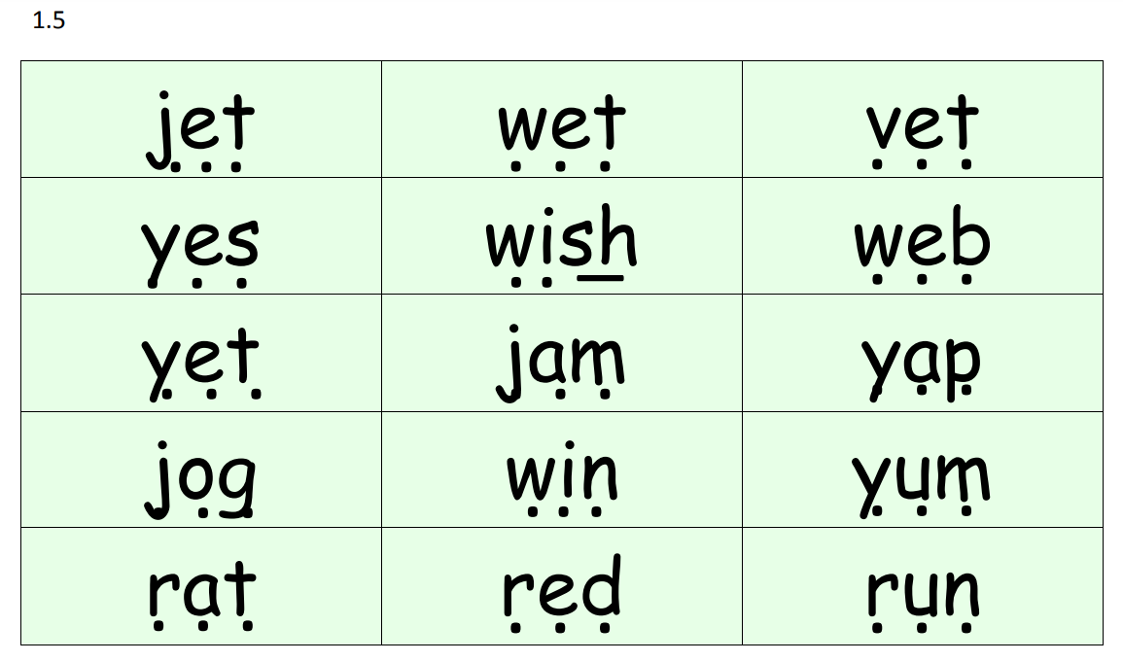
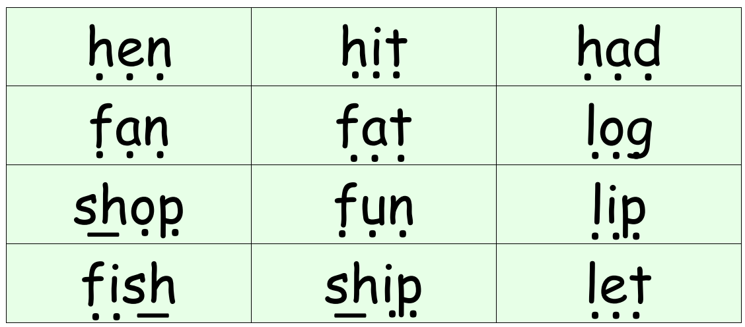
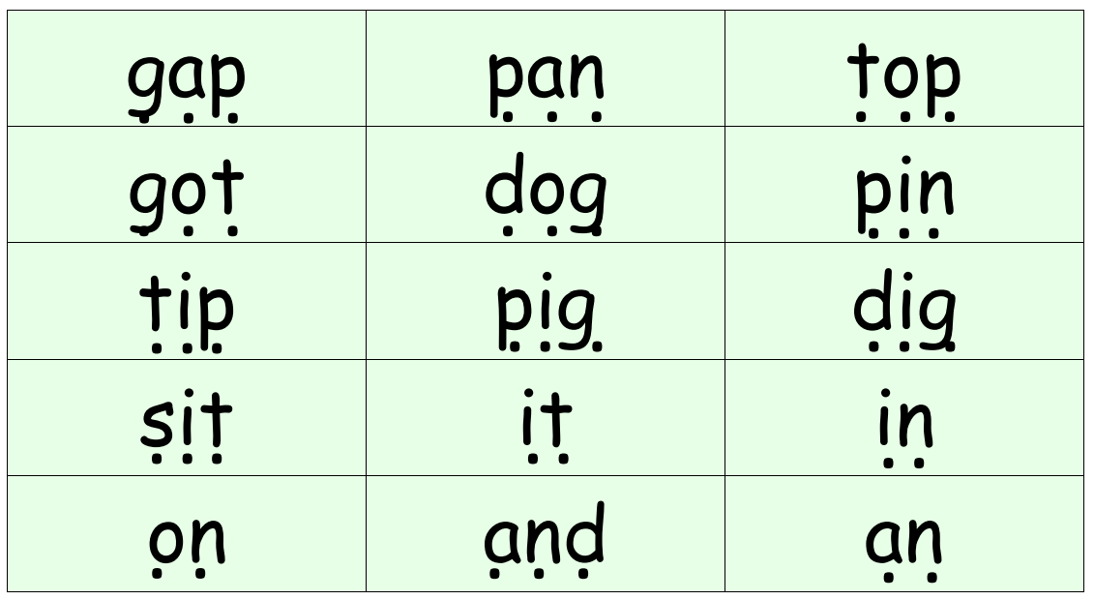
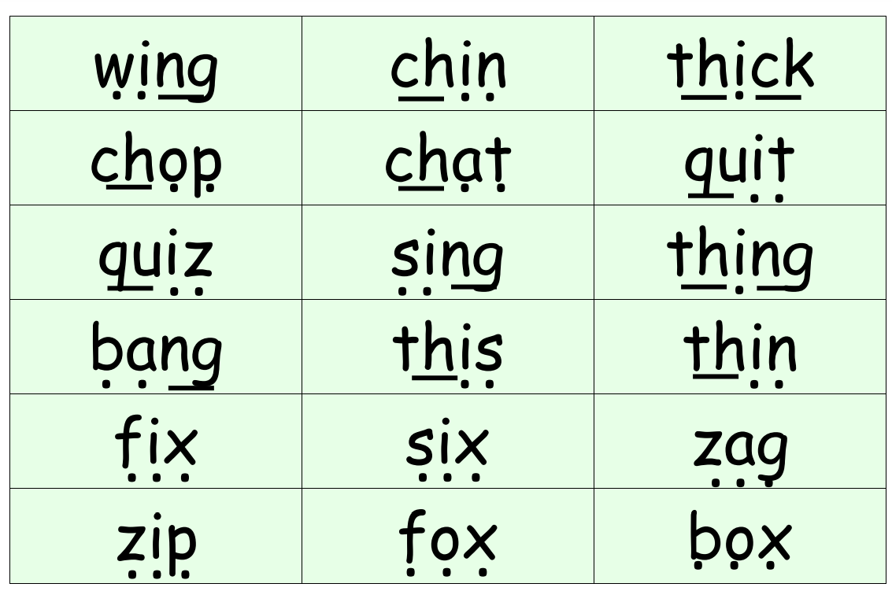
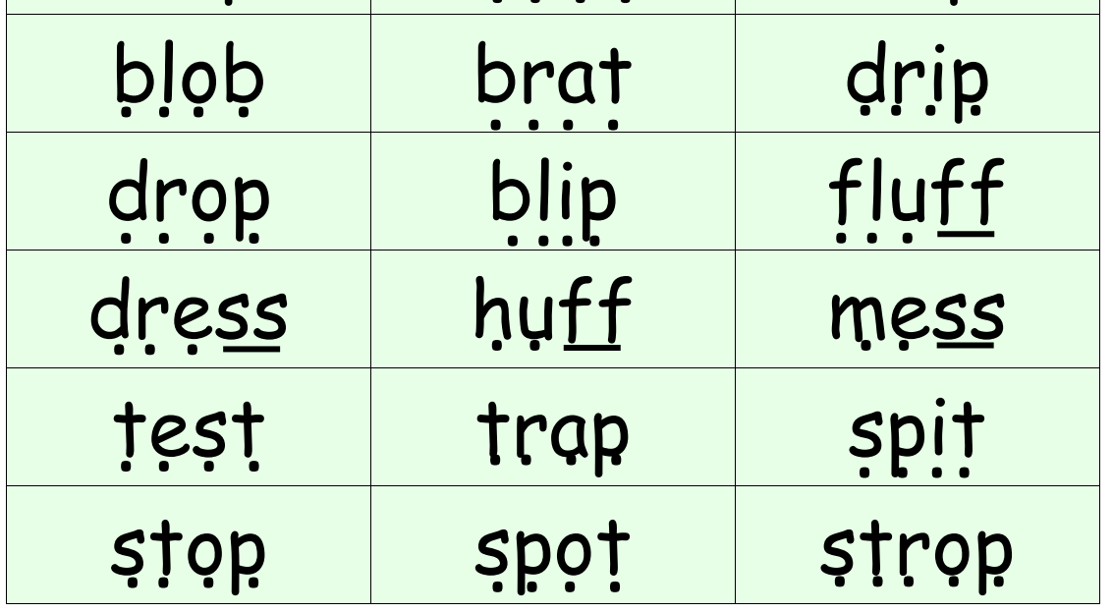
When children are confident in blending they will continue learning new sounds during phonics lessons and will practise reading, writing and spelling more green words containing sounds taught.
We help children to read and blend using dots and dashes. One dot one sound. Dash for ‘special friends’ together that make one sound.

Slide 9
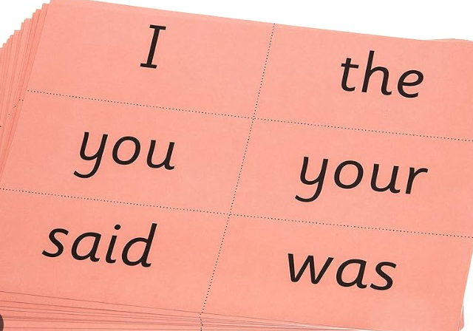
Children will also learn ‘tricky’ or
‘common exception’ words – words
that cannot be segmented and
blended. Children learn to recognise these
words by sight. Children call these
as ‘Red Words’ because they are on red
card.

Slide 10
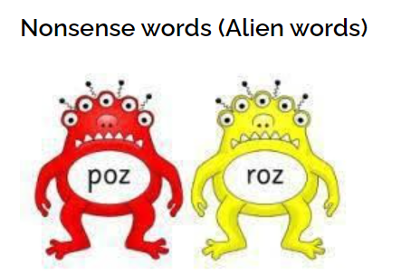
Children also learn to read ‘Alien’ or ‘Nonsense words’. These words feature in the Year One Phonics Screening check in the summer term and will always have a picture of an alien beside them.
The ability to read nonsense words is important because it means that children can then go on to decode difficult words.

Slide 11
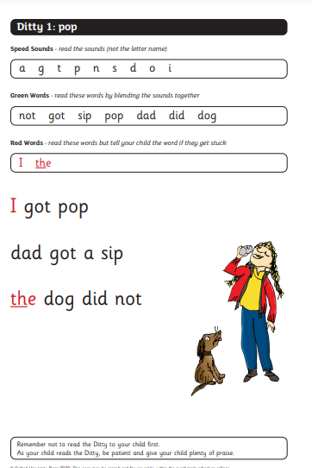
When the children can read all Set 1 single letter sounds they will start to read PCM Ditties.

Slide 12
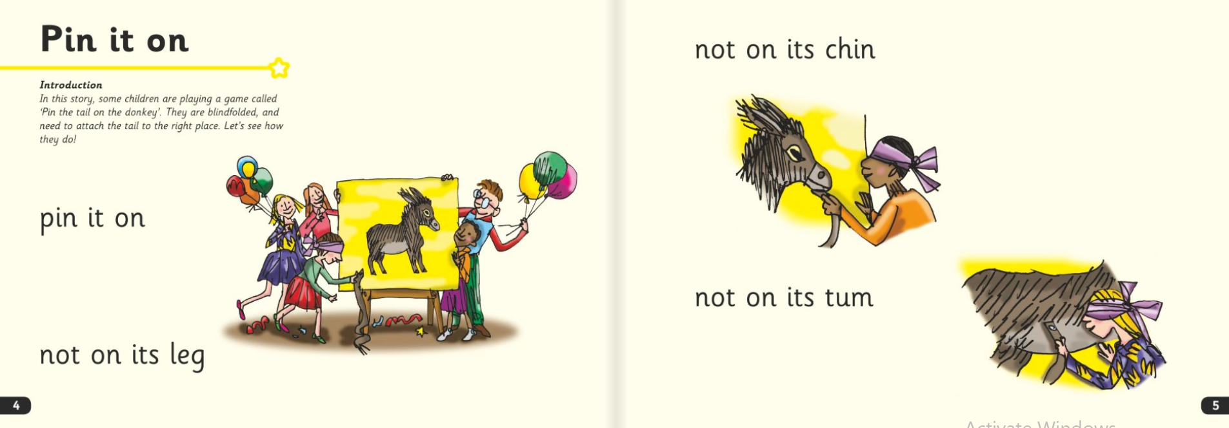
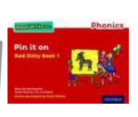
As children’s blending skills improve they will read red ditty books. (Sent home to practise)

Slide 13
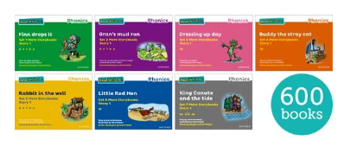
Then children will read each set of coloured story books that get progressively more difficult to read. (Children will read at school and take these books home to read again.)

Slide 14
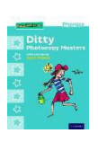
What will my child bring home to read?
Story Books

Slide 15
What books will my child bring home to read?
When they are ready, children will bring home a Storybook that they have just read at school.
The Storybook is matched to the sounds and words they know – a decodable book – so they should be able to read all the words.
Please don’t worry that books are too easy. Children enjoy re-reading stories they know well. Their speed and understanding improves on every read.
They might also bring home:
A RWI Phonics Bag Book: This is matched to the Storybooks children read in school and are used for extra practice. They include many of the same reading activities that we use in class and include parent guidance.
A picture book from the school library – Chosen by your child to take home to read with an adult. They are not expected to read the story themselves

Slide 16
How can I help my with reading and writing at home?
Here are the top four things you can do.
Ask your child to practise reading the Speed Sounds (in their speed sound book) speedily
Ask your child to read and blend the words in the sound blending book.
Ask your child to read the ditties.
Listen to your child read their Read Write Inc. Storybook every day
Practise reading Green and Red Words in the Storybook speedily
Carry on reading stories to your child every day and share the picture books/books sent home
Fred talk
Eye spy
Letter formation
One of the most important things you can do as a parent at home is read to your child. Loving stories is important because children who love stories want to read stories for themselves. Children who read a lot become better readers.

Slide 17
Thank you

