Slide 1
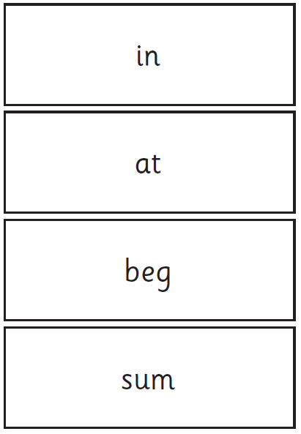
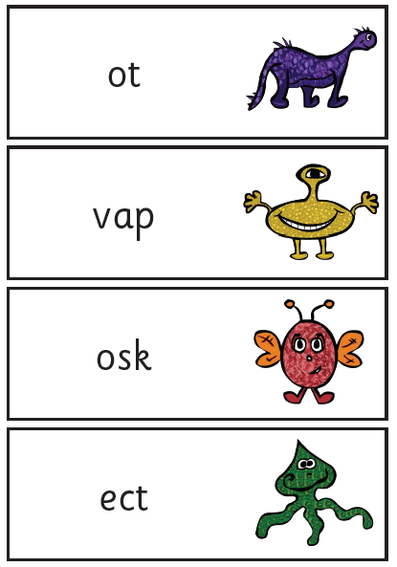
Year 1 Phonics Screening Check
Notes:
The video clip is a short insight into the way children learn to read.
These sounds are practised daily with the children in school and the children are encouraged to apply these sounds to their daily reading and writing.
All of the sounds shown in the video clip are on cards in your pack that you will take away today.

Slide 2

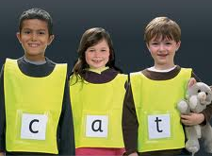

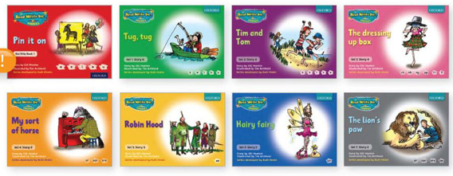
What is phonics?
Phonics is a way of teaching children to read quickly and skilfully.
Children are taught to read by breaking down words into separate sounds or ‘phonemes’. They are then taught how to blend these sounds together to read the whole word.
https://ruthmiskin.com/en/find-out-more/parents/#lg=1&slide=0
We teach phonics, following the Ruth Miskin, Read Write Inc Programme.
Notes:
Children participate in a 30 minute phonics lesson each day.
Children are given a variety of opportunities to apply their phonics learning to everyday reading and writing.
At St Brendan’s we follow the Read Write Inc phonics scheme.
The children learn different sounds and apply this when reading their Read Write Inc books.
Show resources.

Slide 3
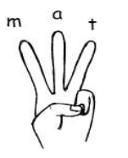
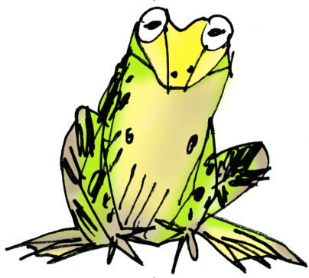
Sounding out
Children learn to say the pure sounds in a word and then to blend the sounds together to say the whole word.
Children are encouraged to use their Fred Fingers to read unfamiliar words.
We call this Fred Talk e.g. l-e-g, b-a-ck, d-o-g, p-e-n, c-u-p,
g-r-ee-n.
Notes:
Show Fred the Frog and explain how it works.

Slide 4
Why is phonics important?
Research shows that when phonics is taught in a structured way, starting with the easiest sounds and progressing through to more complex sounds, it is the most effective way of teaching children to read. It is particularly helpful for children aged 5-7.
Notes:
Almost all children who receive phonics teaching will learn the skills they need to tackle new words.
They can then go onto read any kind of text fluently and confidently and to read for enjoyment.

Slide 5
What is the phonics screening check?
The National Phonics Screening Check is a statutory assessment that was introduced in 2012 to all Year 1 pupils.
It is a quick and easy check of your child’s phonics/reading knowledge.
All children in Year 1 will be participating in the phonics screening check the week beginning 8th June 2025.
The threshold mark will be published on Monday 22nd June 2025. The pass mark has been 32/40 in 2012-2025.

Slide 6
What is the phonics screening check?
It is a list of 40 words and nonsense words.
Your child will read the words in the test one-one with their teacher.
It usually takes about 10 minutes to complete the test.
They will be asked to ‘sound out’ a word and blend the sounds together. The check is very similar to tasks the children already complete during phonics lessons.
Your children are already familiar with this set up as they are participating in many ‘practise’ phonics screen checks throughout the year.
Please watch the following video that will give further information on the phonics screening check.
Notes:
The video shows children reading words from the phonics screening check. It shows what is accepted.

Slide 7
Video https://www.youtube.com/watch?v=LbKGLJPp6ww

Slide 8
How will the results from the phonics screening check be used?
You will be informed of your child’s progress in phonics and how he or she has done in the screening check, towards the end of the summer term.
All of the children are individuals and develop at different stages. The screening check ensures that teachers understand which children need support with decoding.

Slide 9
What if a child struggles with the phonics screening check?
The screening check will identify children who need further support with their phonics decoding skills.
Schools will provide extra help and children will then be able to re-take the assessment in Year 2.
The children will have practised past phonics screening checks many times beforehand so will be very familiar with the process.
However, the 2021 Phonics Screening Check is unseen until the day.

Slide 10
How can I help my child?
There are a number of ways that parents can support reading development:
Read with your child and let your child see you enjoy reading yourself. They are influenced by you and what you do!
Make time for your child to read their school book to you.
With all books, encourage your child to ‘sound out’ unfamiliar
words and then blend from left to right rather than looking at
pictures to guess.
Encourage Fred Fingers if your child is struggling to read a word.

Slide 11
What should I do if my child is struggling to decode a word?
Say each sound in the word from left to right.
Blend the sounds by pointing to each letter, i.e. /b/ in bat, or letter group, i.e. /igh/ in sigh, as you say the sound, then run your finger under the whole word as you say it.
Fred Fingers.
If your child does not understand the word they have read then discuss the meaning.
Always be positive and give lots of praise and encouragement.

Slide 12
Thank you for listening! If you have any concerns please do not hesitate to contact the school office via email or telephone. As always we thank you for your continued support.

