Slide 1


KS2 Assessments
End of Key Stage Two Assessments
Key Stage 2 SATs
2025-2026
(Standard Assessment Tests)

Slide 2
KS2 Assessments
What are end of key stage 2 assessments?
What you might know as SATs or Standard Attainment Tests, are national curriculum tests that are usually taken by children at the end of key stage two.
All children are assessed during the last term of year 6; for 2026, this is in the week beginning 11th May.
The aim of the tests is to establish whether pupils are working at an expected level in English and maths for the end of primary school and the start of secondary school.
The results of the tests do not tell us how accomplished children are in other areas, such as sport, music or art.
Pupils sit six different tests in three subject areas: maths, English reading and English grammar, spelling and punctuation.
English writing and science judgements are made by the pupils’ teachers through teacher assessment, based on evidence of independent writing and work gathered over the course of year 6.
Contents

Slide 3
KS2 Assessments
When do they happen?
Every primary school will test their pupils on the same subject at the same time during the week beginning 11th May 2026. The schedule of tests for this year looks like this:
Assessment week 2026 | Tests
Monday 11th May | English grammar, punctuation and spelling Paper 1: questions (20 minutes) Paper 2: spelling (45 minutes)
Tuesday 12th May | English reading (1 Hour)
Wednesday 13th May | Mathematics Paper 1: arithmetic (30 minutes) Paper 2: reasoning (45 minutes)
Thursday 14th May | Mathematics Paper 3: reasoning (45 minutes)
Contents

Slide 4
KS2 Assessments
What are the children tested on? - SPAG
English grammar punctuation and spelling
Monday - Paper 1: questions (45 minutes) 50 marks
A combined question and answer booklet which assesses pupils’ understanding of the grammar, punctuation and spelling elements of the national curriculum English programmes of study for key stage two.
Monday - Paper 2: spelling (20 minutes but not strictly timed) 20 marks
The paper that pupils receive has 20 sentences, each with a missing word. The teacher reads the sentences one at a time and pupils write in the missing word on their paper.
Pass mark around 38 out of 70
Greater depth score is around 56 out of 70
Total score is 70
Contents

Slide 5
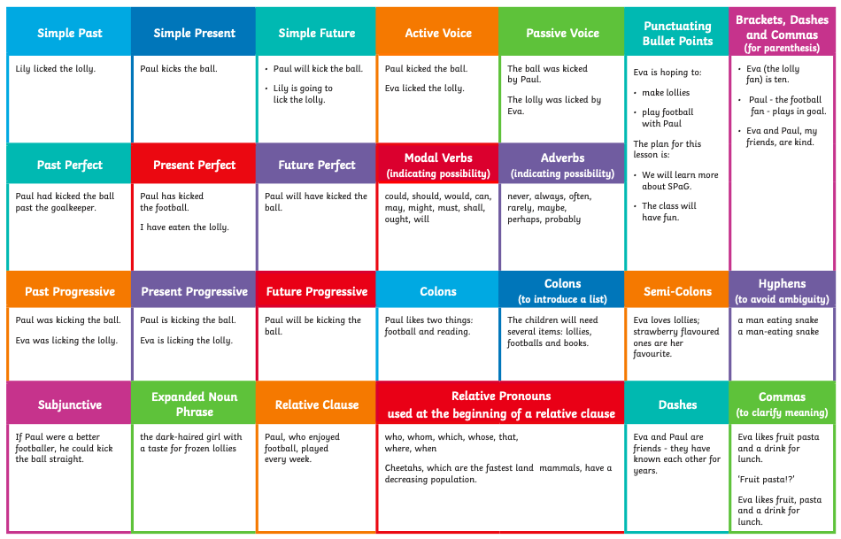
KS2 Assessments
What are the children tested on? - SPAG
Contents

Slide 6
What are the children tested on? - Reading
KS2 Assessments
English
Reading
Tuesday - (1 hour) 50 marks
Pupils will have a reading booklet with three different texts to read and a corresponding question and answer booklet. The texts are presented in increasing levels of difficulty and pupils’ comprehension skills will be assessed against the comprehension elements of the English programme of study for key stage two.
Pass mark around 27 out of 50
Greater depth score is around 40 out of 50
Total score is 50
Contents

Slide 7
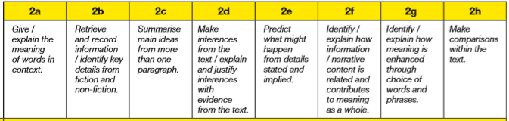
KS2 Assessments
What are the children tested on? - Reading
Contents

Slide 8
What are the children tested on? - Maths
KS2 Assessments
Mathematics
Wednesday - Paper 1: arithmetic (30 minutes) 40 marks
Pupils will have a booklet of arithmetic questions based on the national curriculum maths key stage two programmes of study.
Wednesday & Thursday - Papers 2 and 3: reasoning (40 minutes each) 35 marks each
Both papers will ask children to reason and solve problems, again based on the national curriculum maths programmes of study.
Greater depth score is around 92 out of 110
Pass mark around 58 out of 110
Total score is 110
Contents

Slide 9
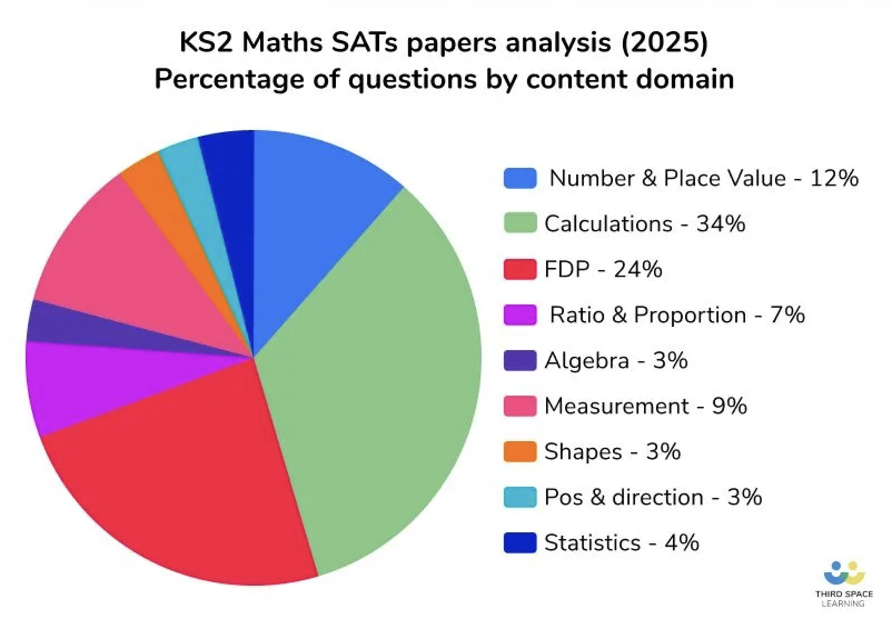
What are the children tested on? - Maths
KS2 Assessments
Contents

Slide 10
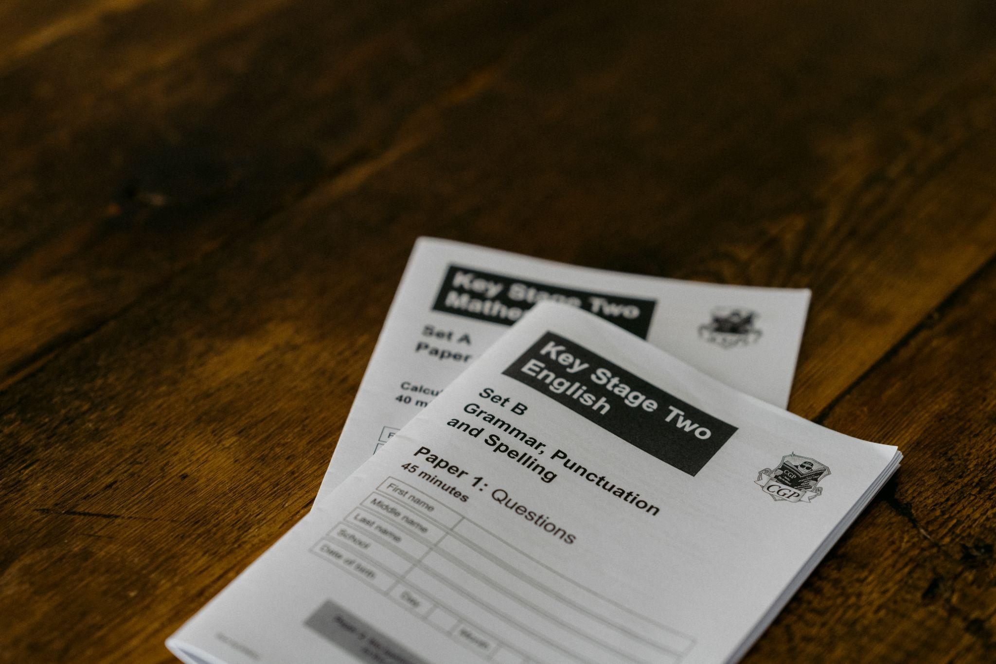
KS2 Assessments
How are the tests administered?
Children need to arrive in school early so that we are ready for a 9:15 start.
We will provide breakfast if needed.
Children will be split across the Year 6 and Year 5 classroom and given a desk each.
As the children complete their tests, they will be monitored by the teaching staff.
Children can ask for questions to be read.
Children can go to the toilet during the tests.
All tests are sent straight back each day, we don’t get to see them or mark them.
Contents

Slide 11
KS2 Assessments
What happens with the results?
School results will be shared with the school, their local authority or academy trust and Ofsted to support school improvement.
Scans of marked pupil test papers and test results are published online in July 2026 and can be accessed by the school (Tuesday 7th July 2026).
Each child will receive a scaled score for their performance on the tests. This is a score between 80 and 120, where a score of 100 is considered to be average or working at the expected level of attainment at the end of primary school.
We will share pupils’ results in their end of year written report, which is sent home to parents on Friday 10th July 2026.
80 to 99 = Working toward expected standard
100 to 109 = Working at expected standard
110 to 120 = Working above expected standard
Contents

Slide 12
KS2 Assessments
How can I help my child?
Support your child to complete any home learning tasks sent home, such as spelling activities, reading comprehensions and maths sheets.
Use online activities like Grammar Bug, Times Tables Rock Stars, MyMaths to practise skills at home.
Make sure they go to bed at a reasonable time, have a good breakfast and arrive at school on time during the assessment week.
Encourage them to try their best, commend their efforts and plan to celebrate their hard work at the end of the testing week, rather than focusing on the test results.
Contents

Slide 13

KS2 Assessments
How can I help my child?
Support your child to complete any home learning tasks sent home, such as spelling activities, reading comprehensions and maths sheets.
Use online activities like Grammar Bug, Times Tables Rock Stars, MyMaths to practise skills at home.
Make sure they go to bed at a reasonable time, have a good breakfast and arrive at school on time during the assessment week.
Encourage them to try their best, commend their efforts and plan to celebrate their hard work at the end of the testing week, rather than focusing on the test results.
Contents

