Slide 1

St John Fisher RC Primary School RHE and PSHE
Programme
At St John Fisher RC Primary we follow the diocesan approved programme ‘Life to the Full Plus’.
This includes Life to the Full, Ten Ten’s programme in Relationship and Health Education for Catholic primary schools in England, and an add on PSHE programme.

Slide 2
St John Fisher RC Primary School RHE and PSHE
Programme
Relationships and Health Education based on the Department of Education guidance became statutory during the academic year 2020/21. The Life to the Full programme is rooted in a Christian understanding of the human person, based on “A Model Catholic RSE Curriculum” provided by the Catholic Education Service.

Slide 3

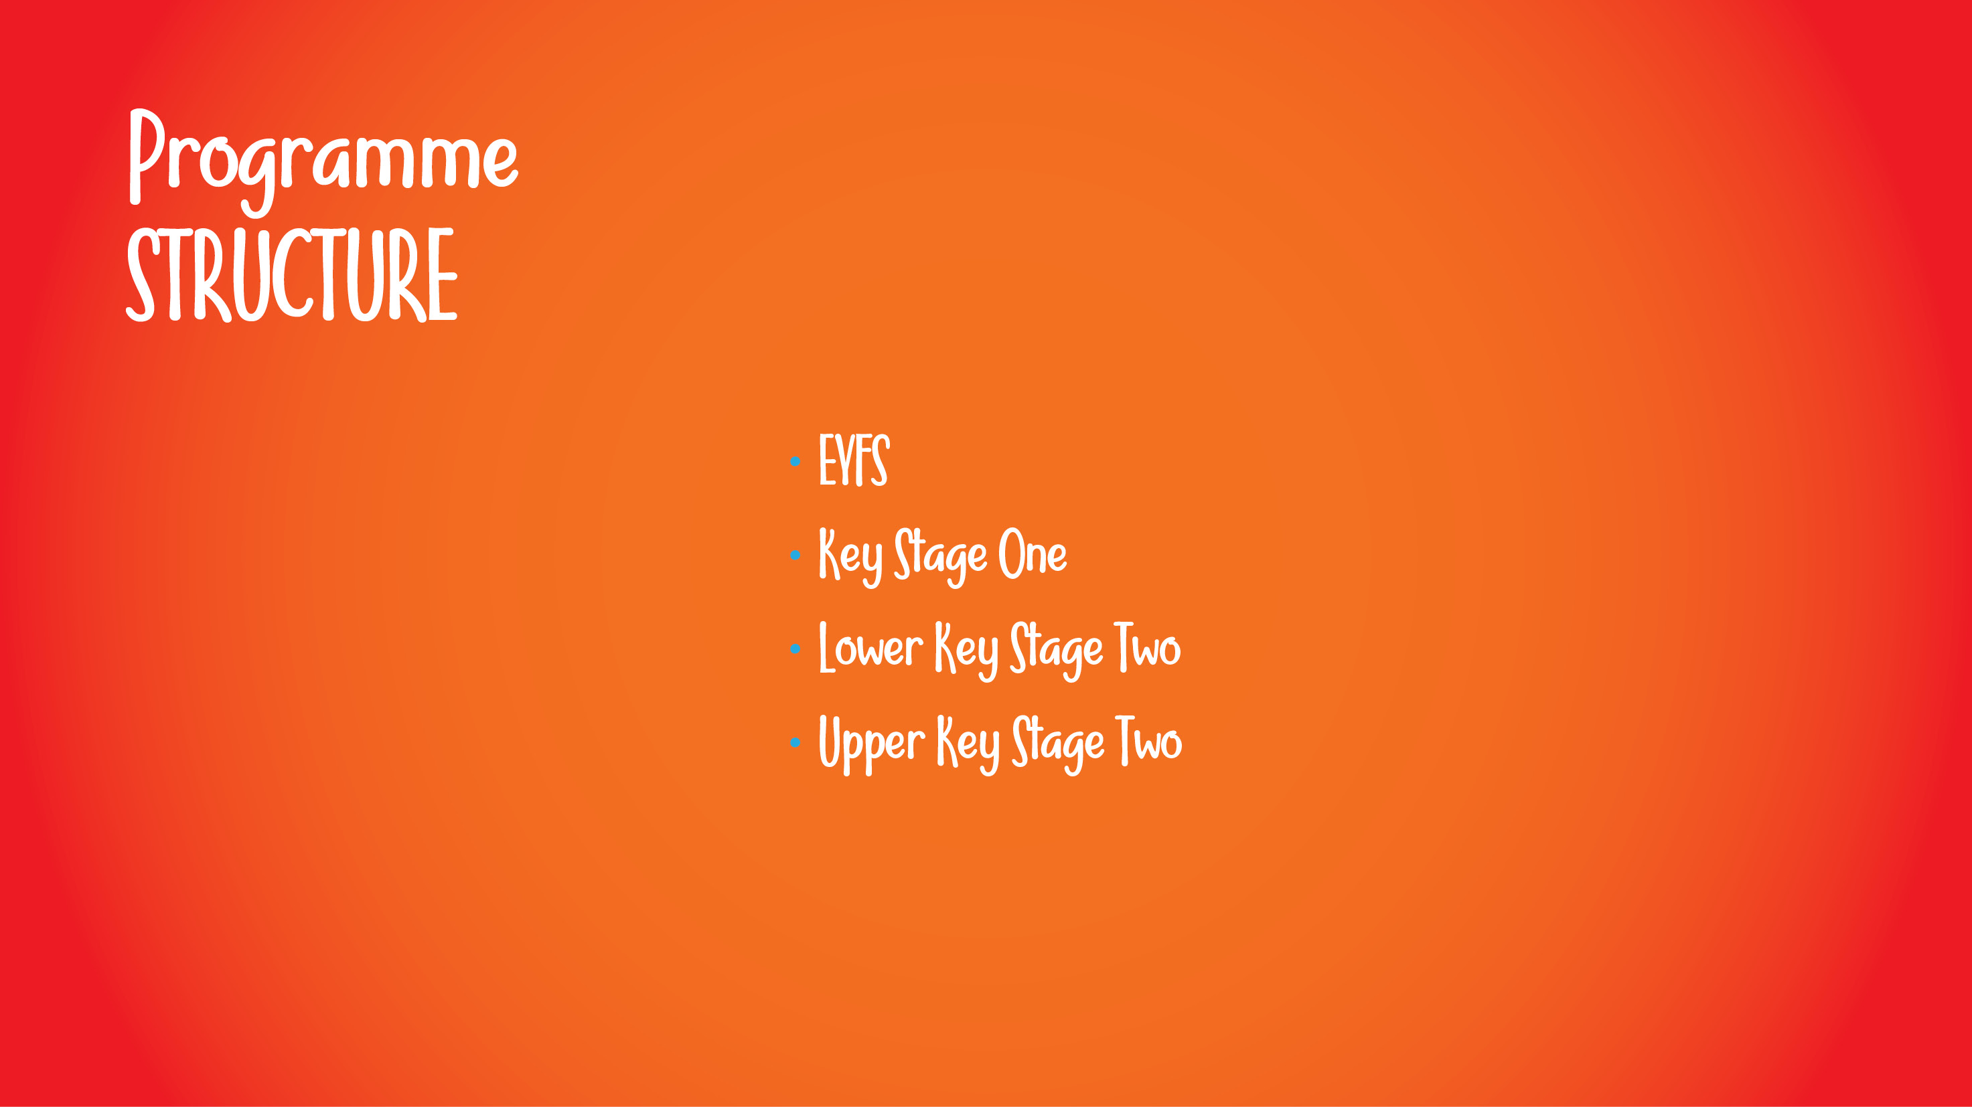
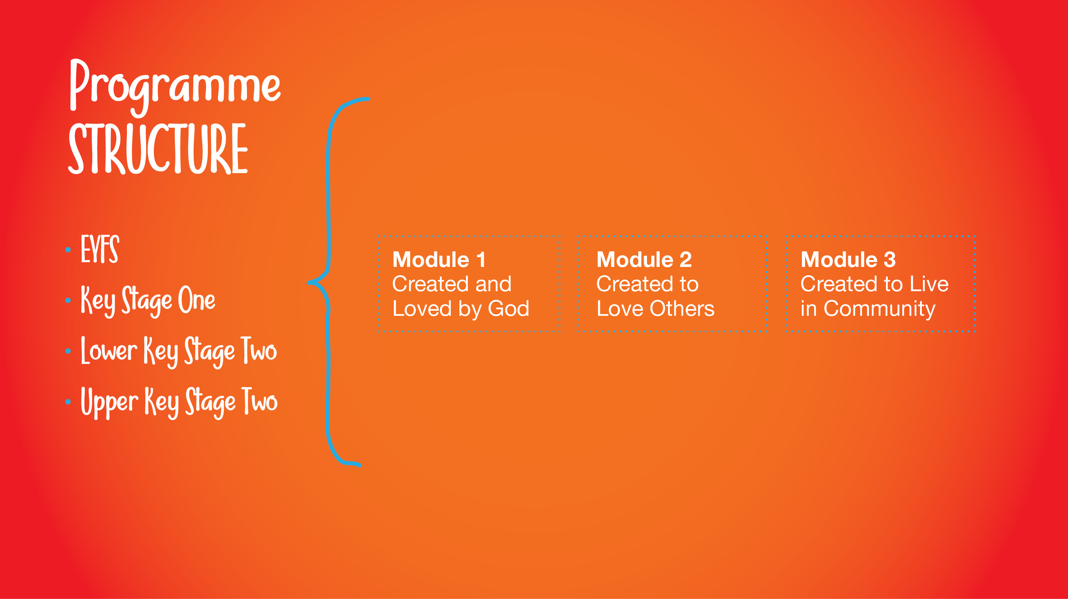
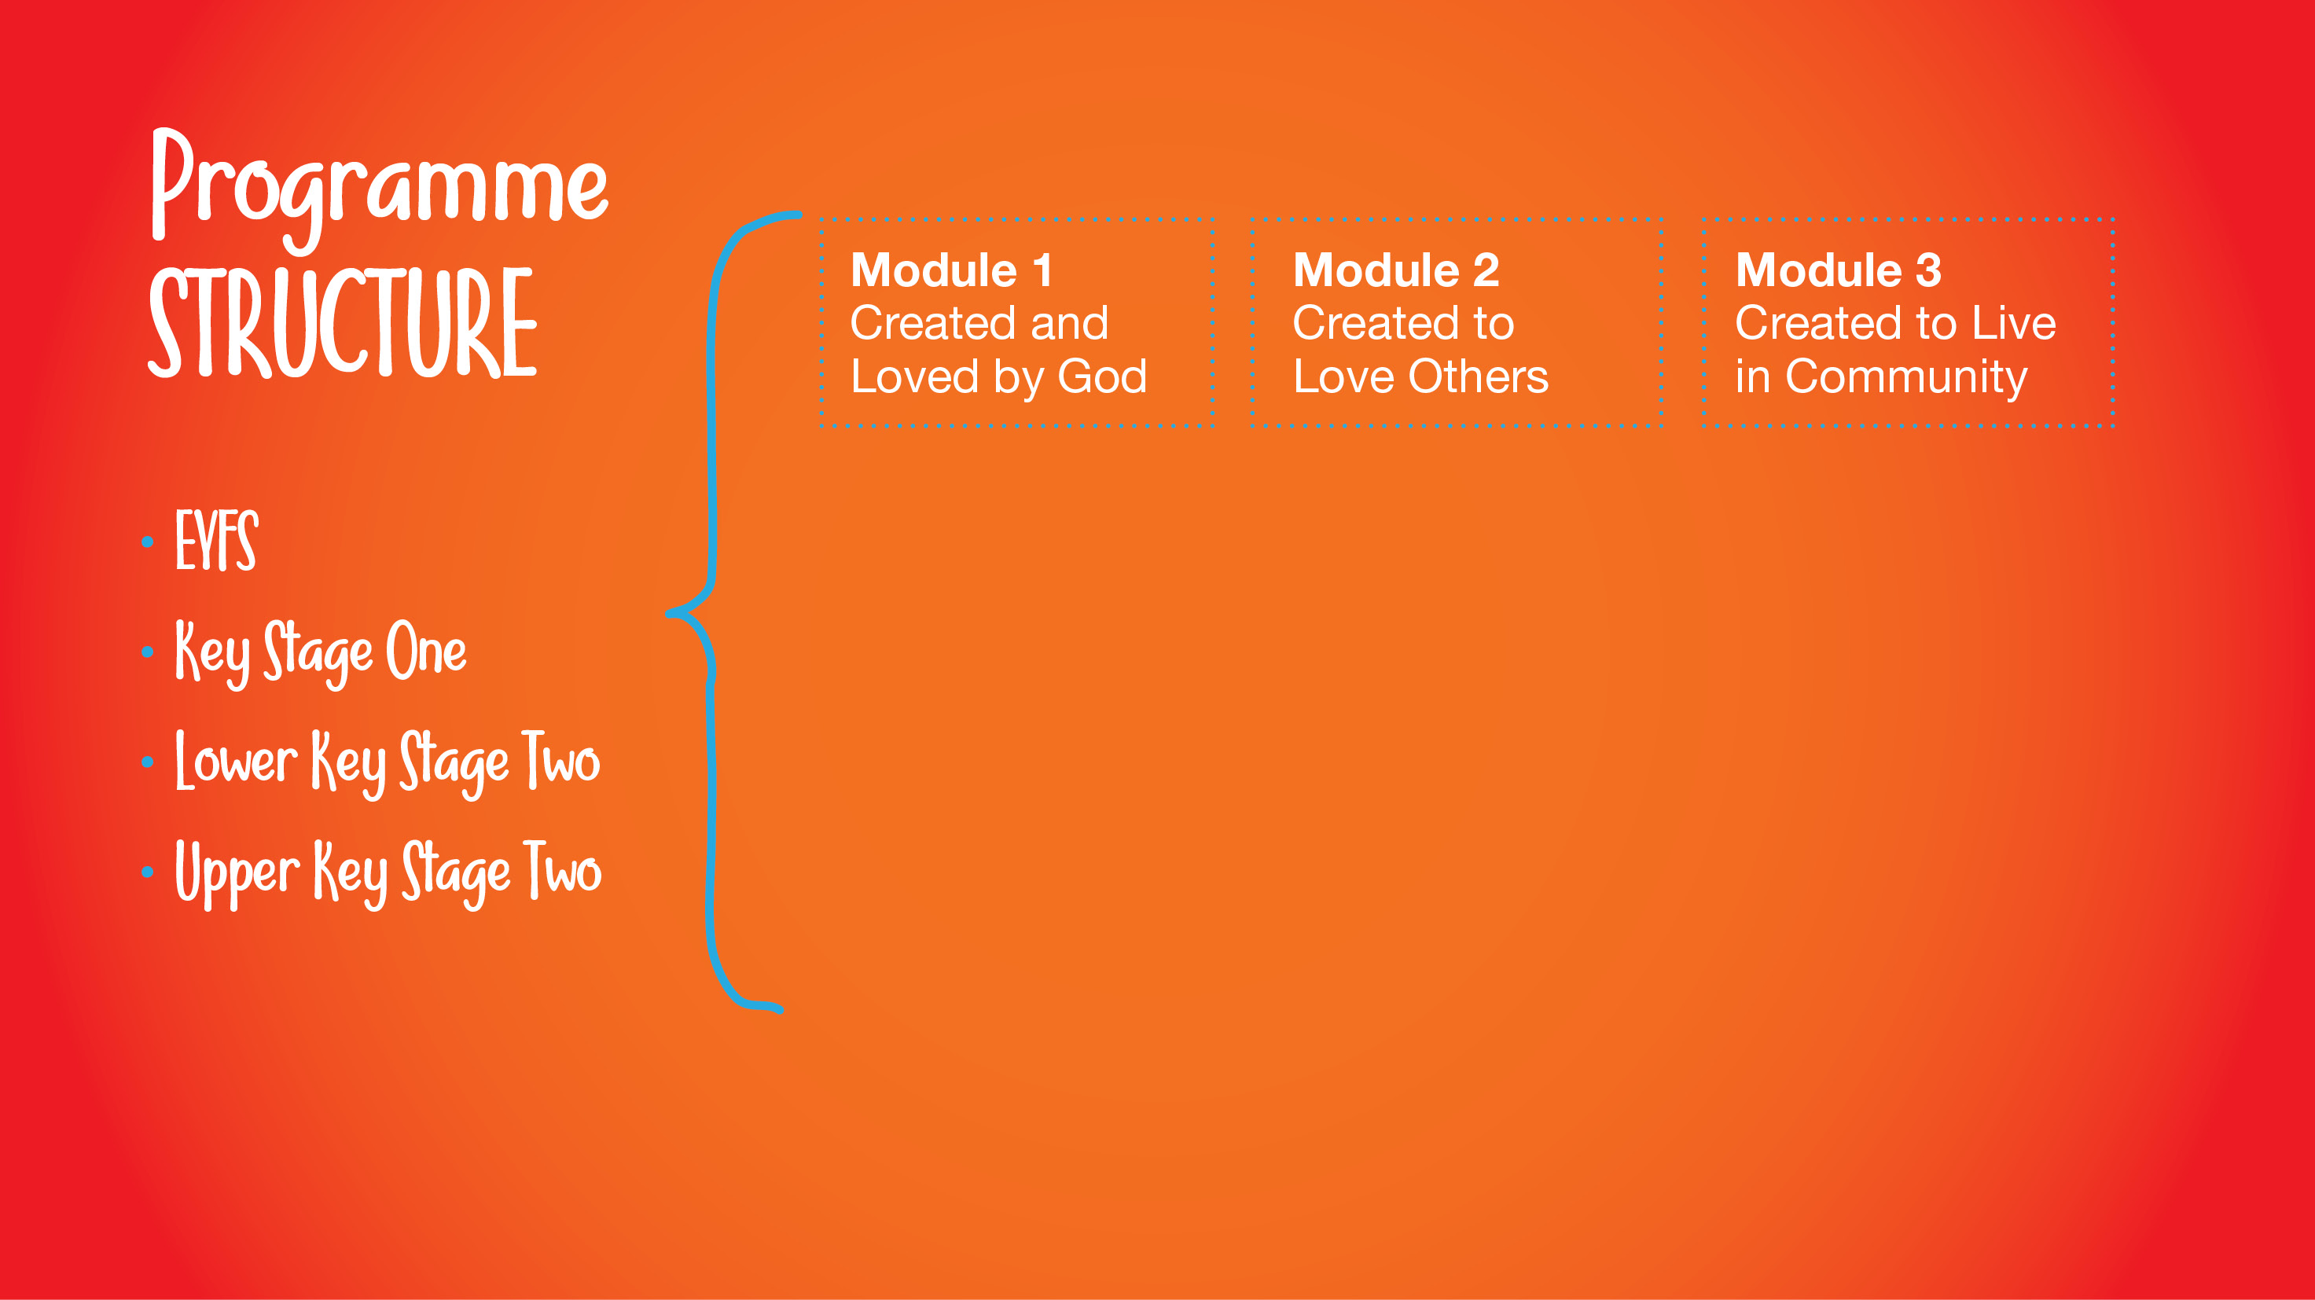
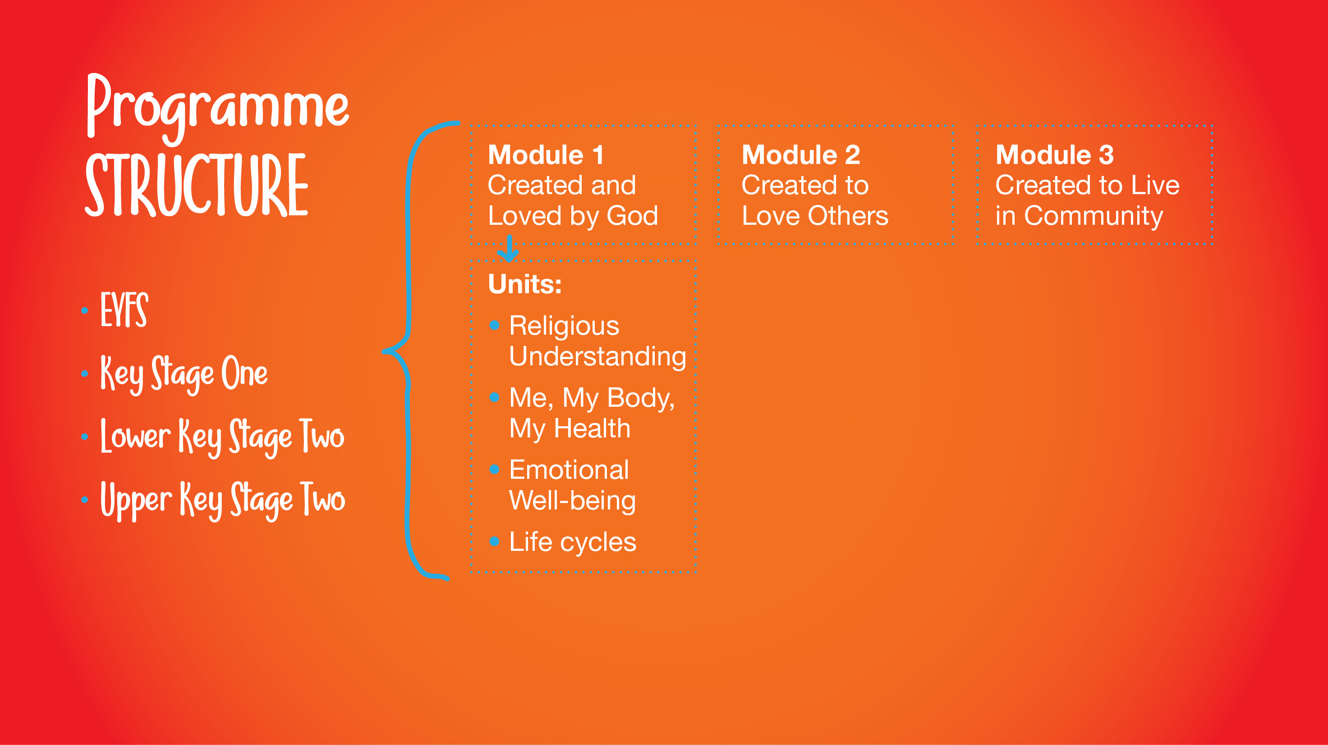
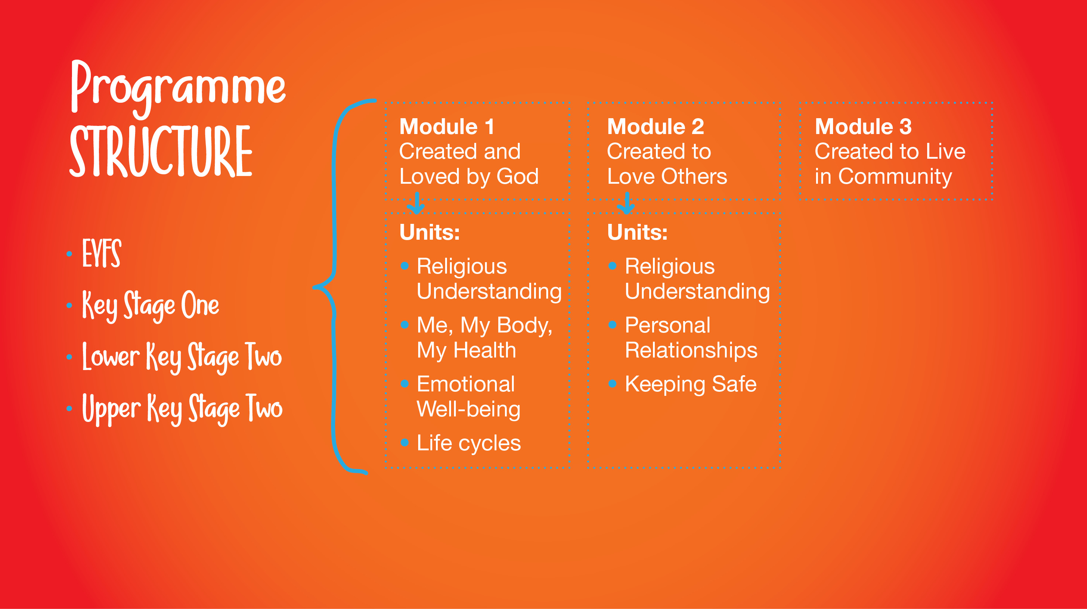
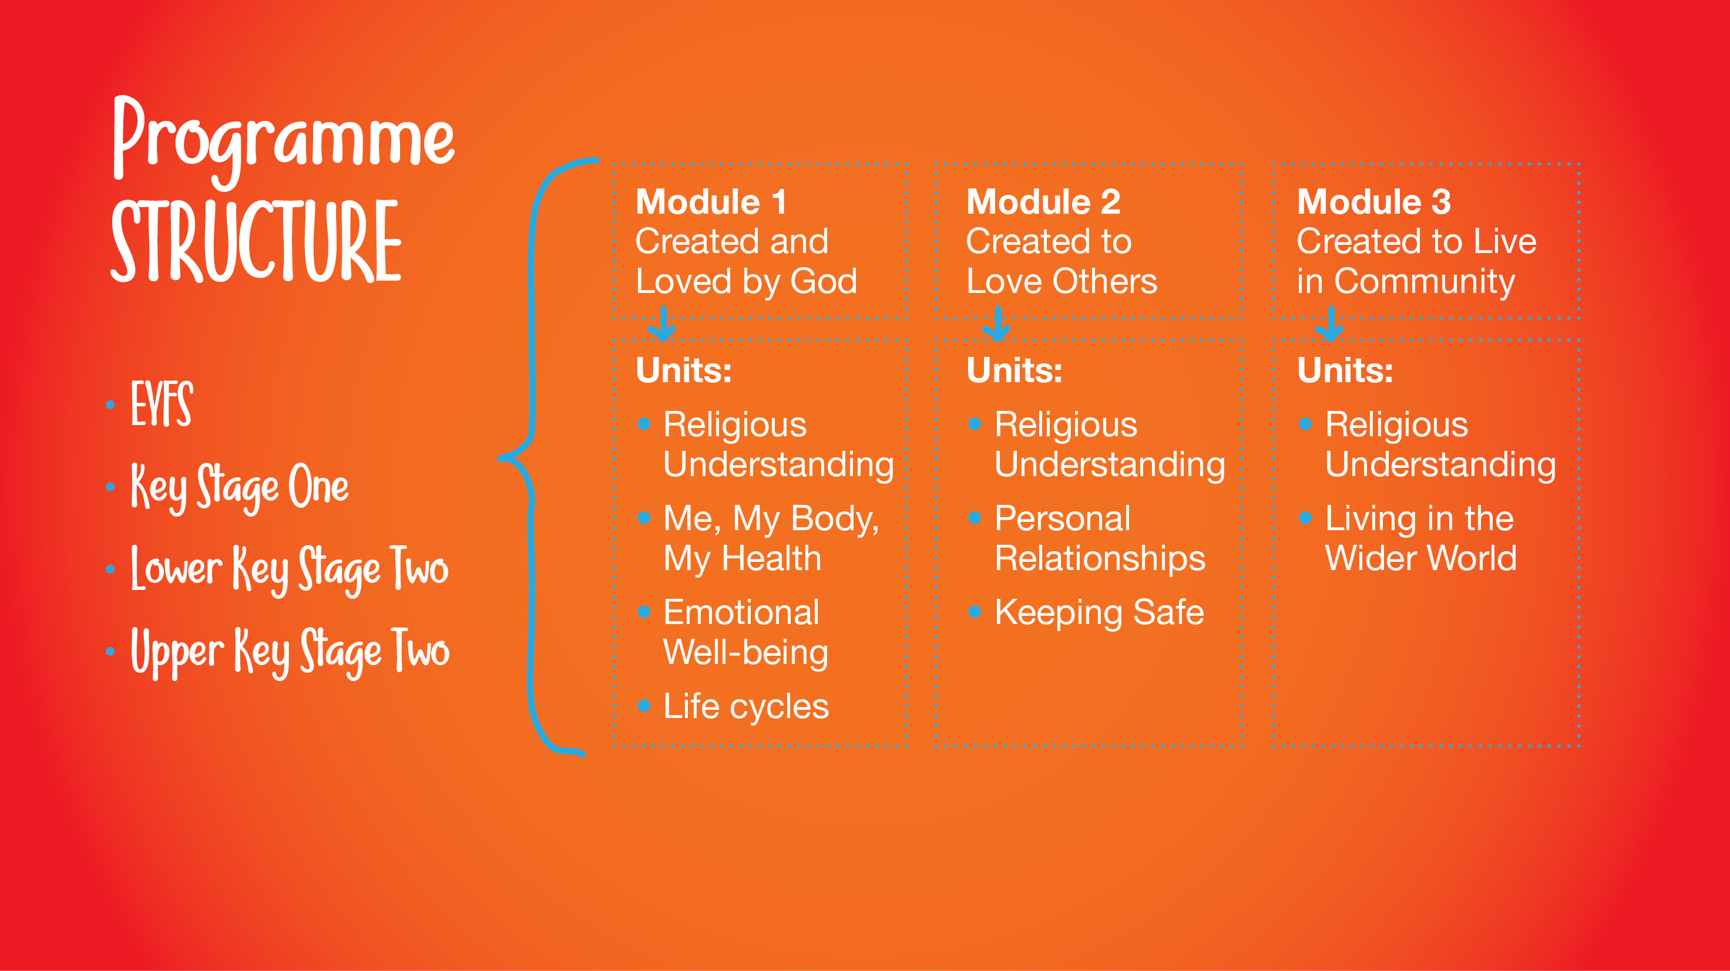
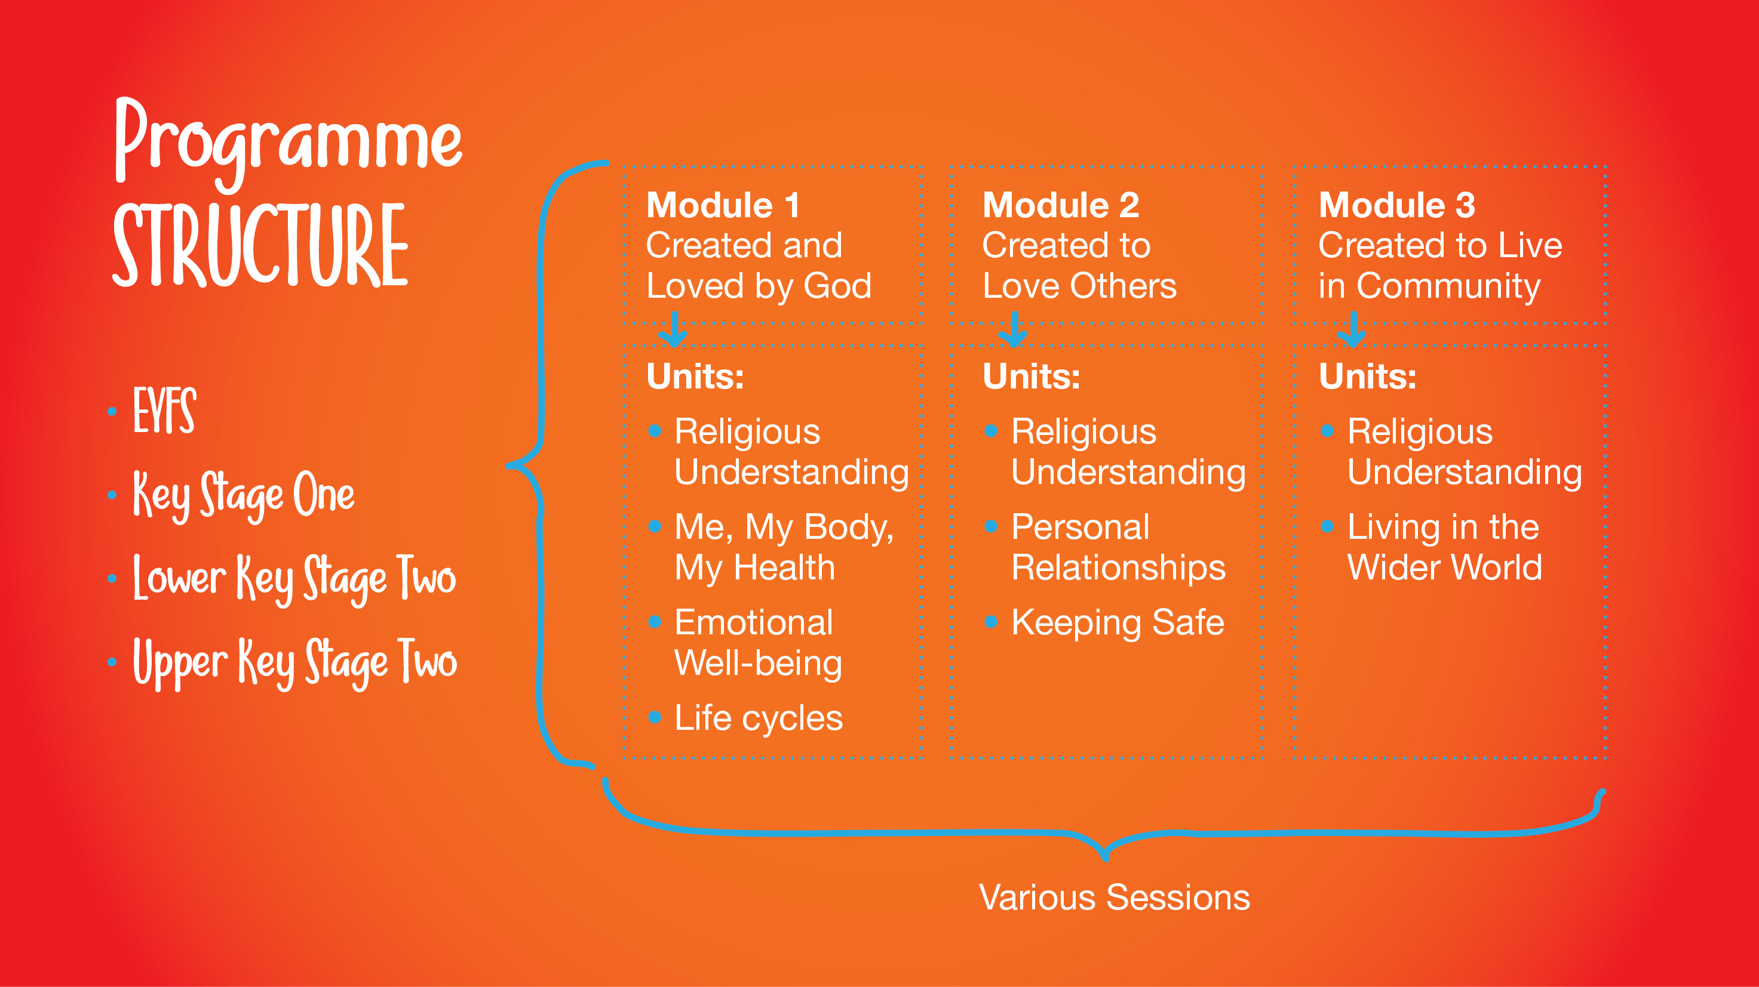
Money
The World of Work

Slide 4
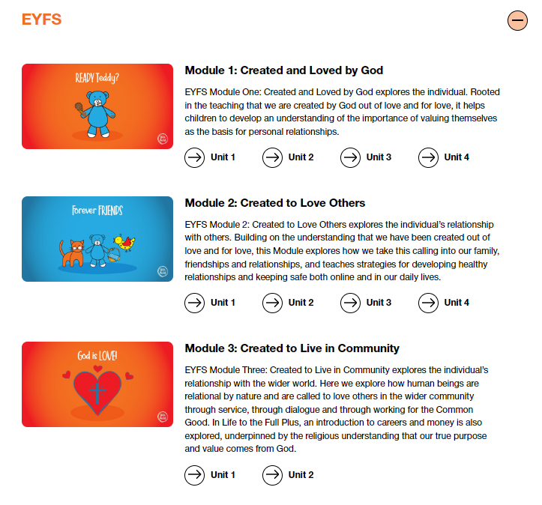
An overview of each module.
Module 1 – Autumn Term
Module 2 – Spring Term
Module 3 – Summer Term

Slide 5
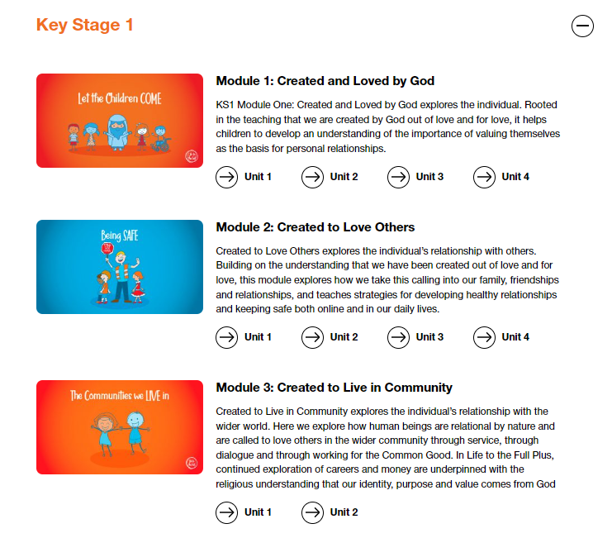
An overview of each module.
Module 1 – Autumn Term
Module 2 – Spring Term
Module 3 – Summer Term

Slide 6
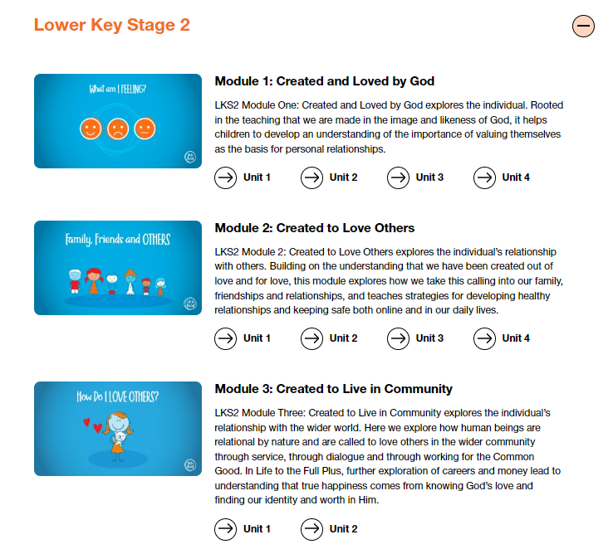
An overview of each module.
Module 1 – Autumn Term
Module 2 – Spring Term
Module 3 – Summer Term

Slide 7
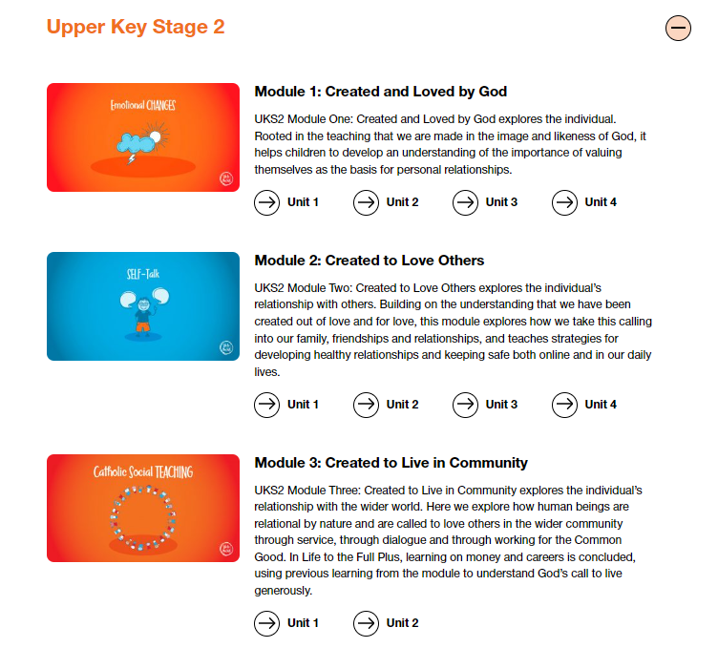
An overview of each module.
Module 1 – Autumn Term
Module 2 – Spring Term
Module 3 – Summer Term

Slide 8
St John Fisher RC Primary School RHE and PSHE
Programme
In England, Sex Education is not statutory. The following slides show the yearly overview of topics explored within Life to the Full Plus for each key stage and highlight the non-statutory or sensitive topics that parents might want to discuss with teachers before the programme is delivered.
Parents and carers will be informed by letter when the more sensitive aspects of our RSHE programme will be delivered, in order that they can be prepared to talk and answer questions about their children’s learning.

Slide 9
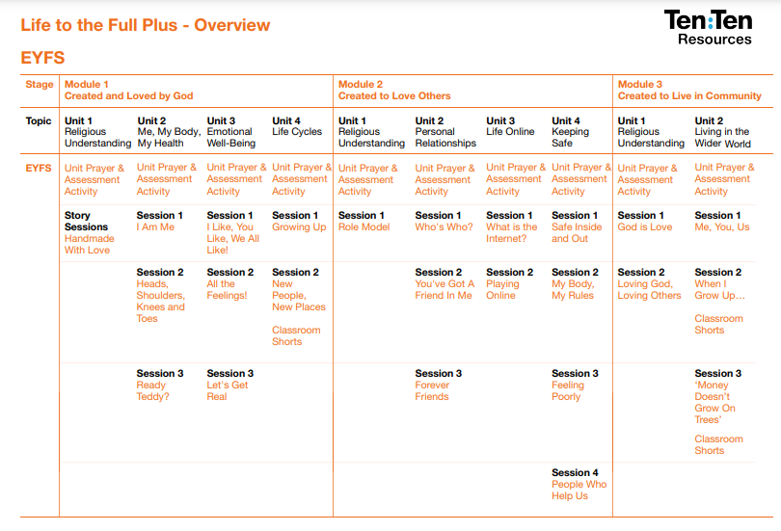

Slide 10
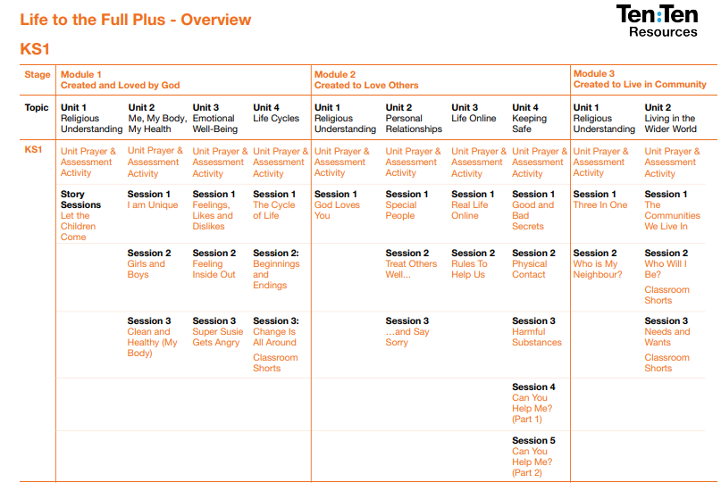
Sensitive Topic
During the topic ‘Girls and Boys’ taught in the Autumn Term we introduce the names of genitalia to Year 1 and 2.
These words may be used again during NSPCC PANTS Workshops (letters sent home – see dates for diary).

Slide 11
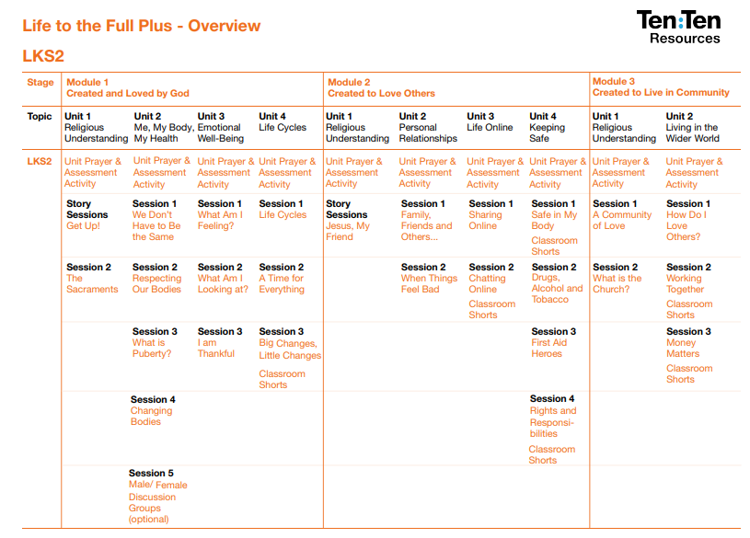
Sensitive Topics We provide two sessions on puberty in the Autumn Term: What is Puberty? and Changing Bodies. (NHS Website - It's completely normal for puberty to begin at any point from the ages of 8 to 14. The process can take up to 4 years.” ) Module One, Unit 4, in a session called Life Cycles in which children learn about the human reproductive system. However, it does not discuss sexual intercourse.

Slide 12
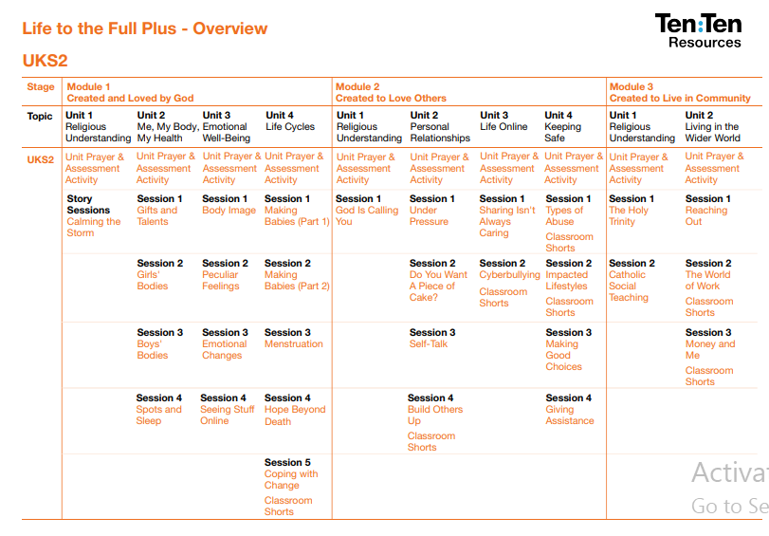
Sensitive Topics One of the sessions in Upper Key Stage Two, Seeing Stuff Online, Autumn Term, addresses the risks that children face from seeing explicit images and videos online. Year 6, Making Babies, Autumn Term, Sexual intimacy is discussed within the context of a heterosexual marriage, and the Catholic-Christian point of view is clearly stated. Pupils will learn: Basic scientific facts about sexual intercourse between a man and woman The physical, emotional, moral and spiritual implications of sexual intercourse The Christian viewpoint that sexual intercourse should be saved for marriage

Slide 13
St John Fisher RC Primary School RHE and PSHE
Programme
Year Six - Life to the Full Plus LGBT Content
The programme examines difference and bullying, but does not explicitly highlight LGBT people within this context.
The presenters on film say that some children have ‘two mums and two dads’ as part of a list of different family set-ups – this is the only explicit reference to same-sex relationships in the programme.
Children are taught to recognise prejudice and discriminatory behaviours in themselves and others. In the context of hearing various descriptions of prejudiced actions, children learn that homophobia is being prejudiced against someone because they are attracted to someone of the same sex.
Children will explore the concept of gender stereotypes and how these stereotypes might make us feel.
Children will be taught that gender identity is separate from sexual orientation. Children will be encouraged to celebrate God's creation by valuing the uniqueness of each and every person.

Slide 14
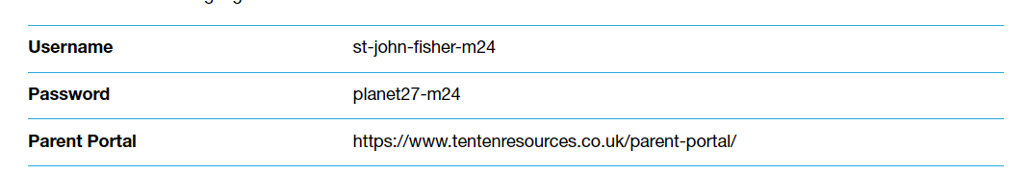
Please login to the parent portal to find out more interesting information.
Please contact the school with any further questions.
Thank you.

