Slide 1

St John Fisher RC Primary School
Year 4 Multiplication Tables Check

Slide 2


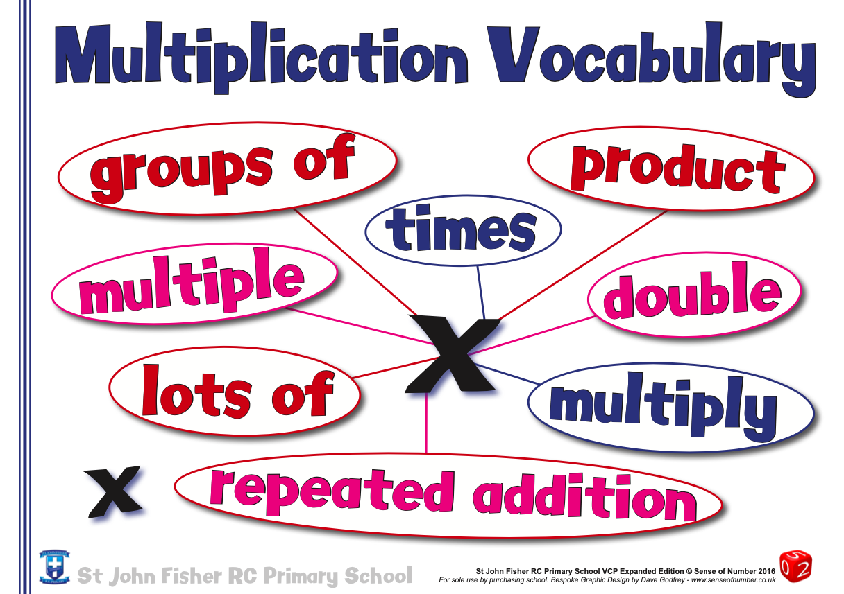
What is the Year 4 times tables test?

Slide 3
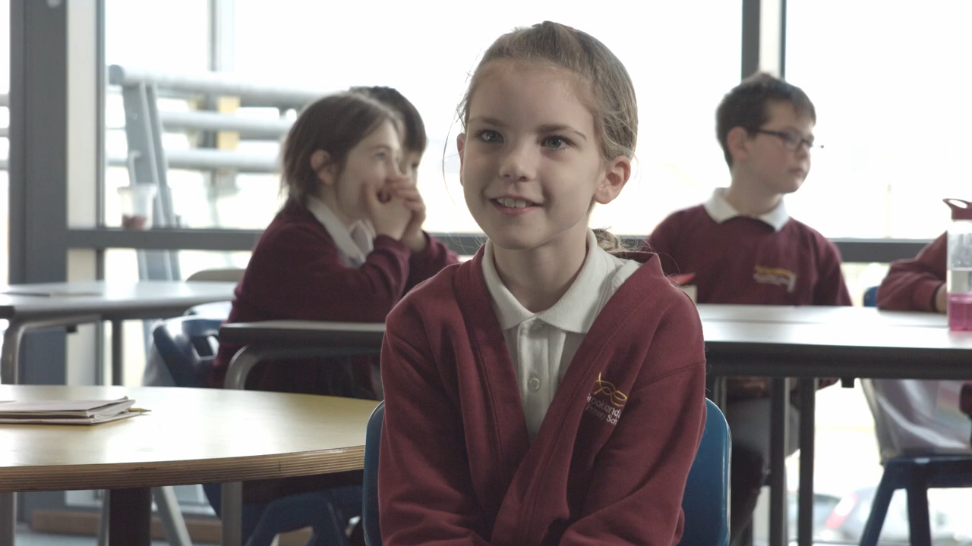

Slide 4
Key Points:
Introduced as a trial in 2019 with a view to going ‘live’ in June 2020. But now postponed until June 2022
There will be 25 questions on an iPad based on the 12 times tables e.g. 6 x 5 = ___ and so on.
Children will be given 6 seconds per question (with a 3 second gap).
There will be 3 practice questions before the test begins.
The test will mainly be based on the 6, 7, 8, 9 and 12 times tables.
The test will take 5 minutes to complete.

Slide 5
So what happens after the test?
No child will fail as there is no pass mark.
The test is purely to help us know what gaps there might be for each child.
The results are not published or given to the children (or parents).

Slide 6

How are we getting ready in school?
6, 7, 9 & 11’s

Slide 7
Daily times tables practice.
Paper form
Online form
Songs
Games

Slide 8


Slide 9
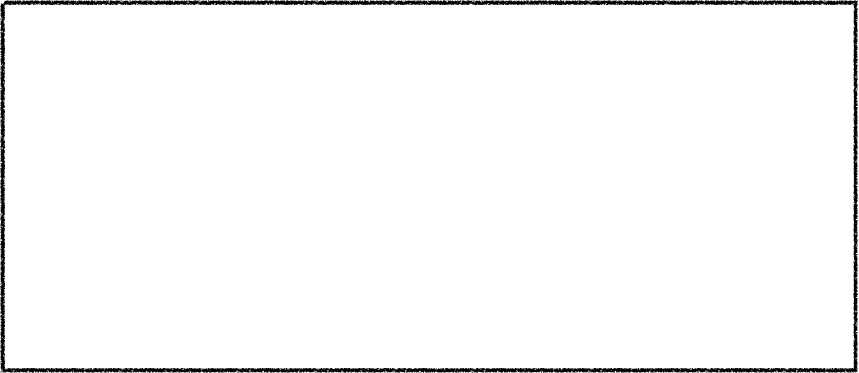
What can you do?
Language
There are many different ways to say the tables and they’re all correct –
but it helps if you’re consistent and if you adopt the language your child already uses in school.
For example we have;
Three times eight is…
Three multiplied by eight...
Three eights are…
Three lots of eight…
Three groups of eight are…
The product of 8 and 3 is…

Slide 10


Useful Tips
Stick to one table at a time to minimise confusion.
Start with chanting and writing them out slowly in order.
Then move on to completing the answers quickly in order – on paper or verbally with your child.
Finally, move on to completing the answers in any order.
Keep reminding your child that 3 x 4 is the same as 4 x 3 – this is effectively halves the number of tables facts.
Each table has a square number 3 x 3, 7 x 7 etc. These are special numbers that can act as a memory hook – emphasise them!
Talk about the numbers as you are encountering them “ 5 x 7 = 35 that’s our house number” – this makes more memory hooks.

Slide 11


Games
Super Fingers!
This is a game for two players.
The game is basically a version of rock, paper, scissors but with numbers. Two players count to 3 and then make a number using their fingers.
Both players then have to multiply both numbers together and the quickest wins.

Slide 12


Games
Multiplication Snap!
You will need a deck of cards for this game. 1. Flip over the cards as though you are playing snap.
2. The first to say the fact based on the cards turned over (2 and 3 say 6) gets the card.
3. The person to get all of the cards wins.

Slide 13

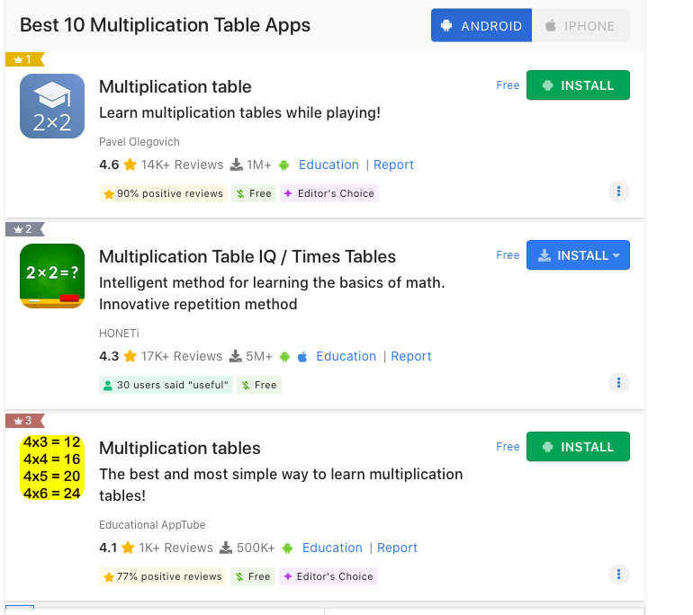

Games, Apps & Songs

Slide 14
Thank you for coming!

